Slide 1
Progress Update
2022. 11.15
송희수

Slide 2
Patient Sample (Positive)
PB417_01
S1_W1_Px1_Py1_C1
S1_W1_Px1_Py1_C2
S1_W1_Px1_Py1_C3
S1_W1_Px1_Py1_C4

Slide 3
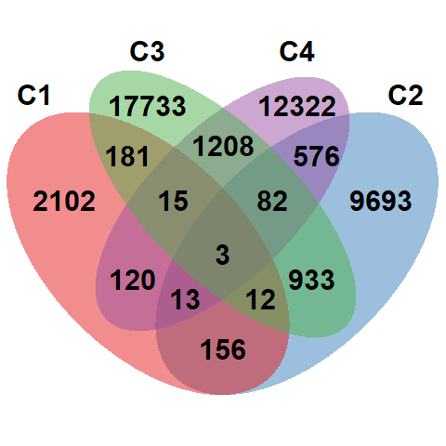
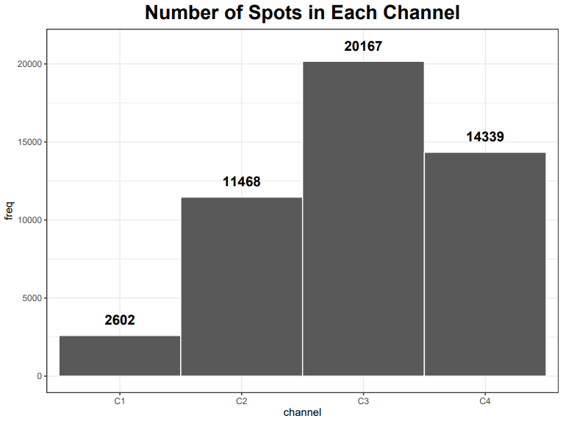
Explore Data (Patient Sample)

Slide 4
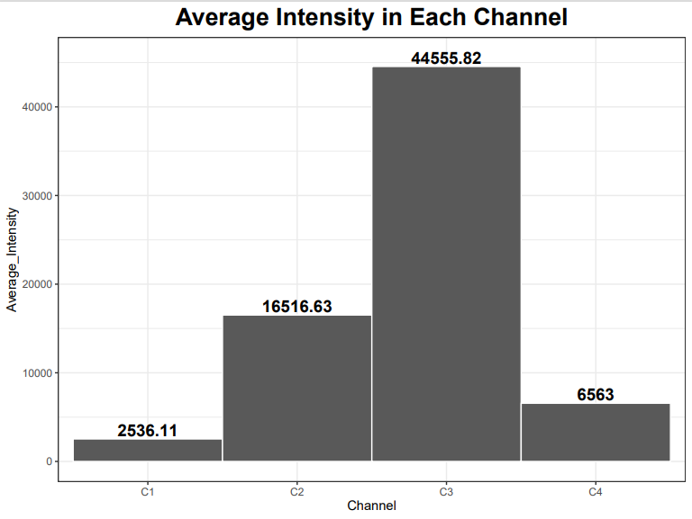
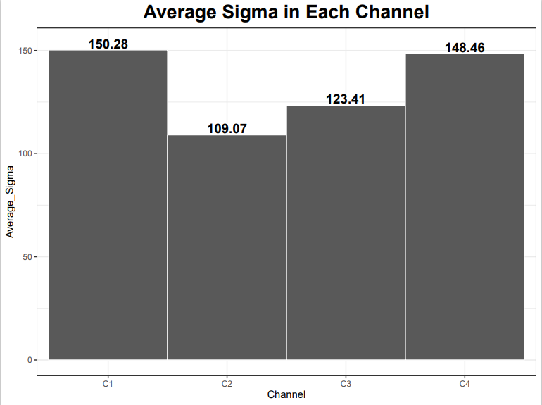
Explore Data – Average sigma/intensity

Slide 5
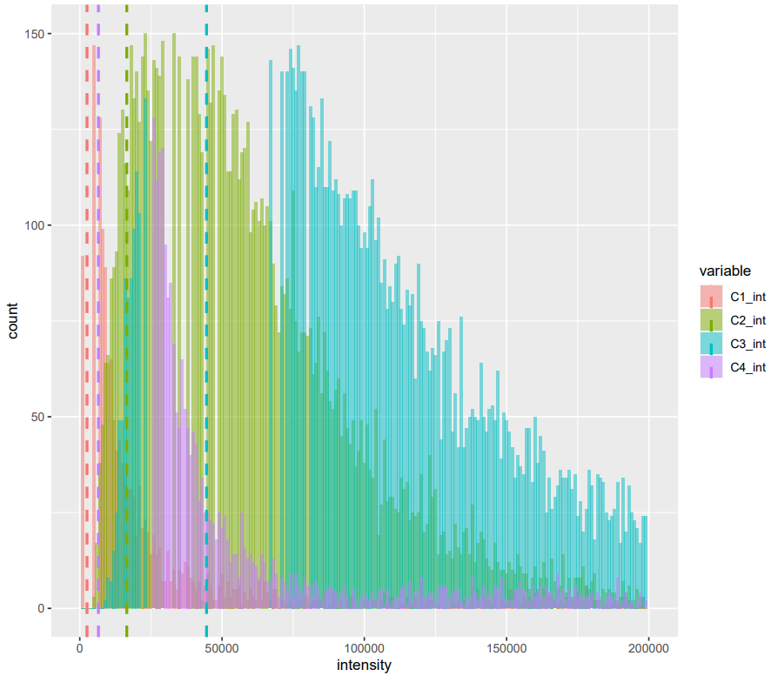
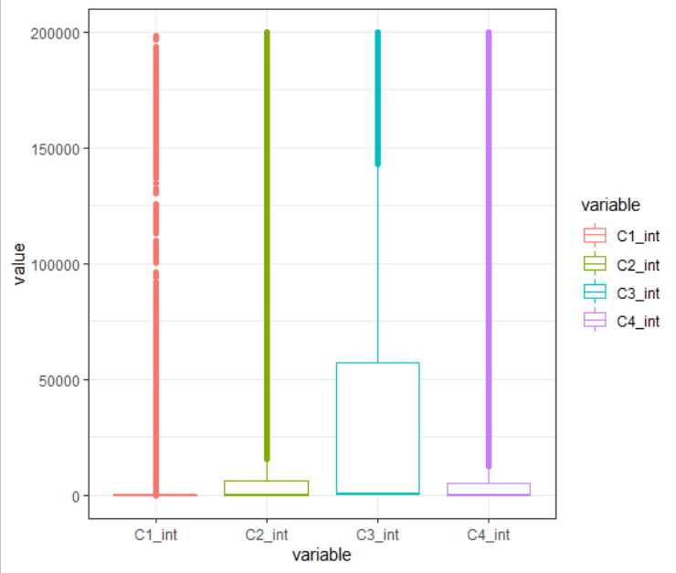
Explore Data – Intensity distribution

Slide 6
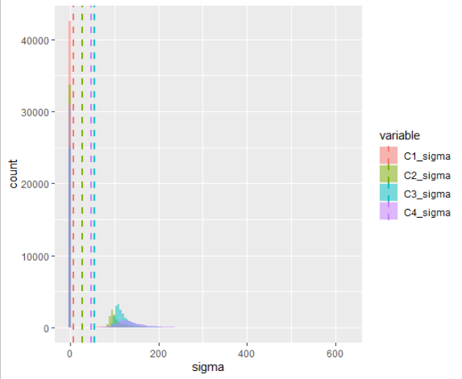
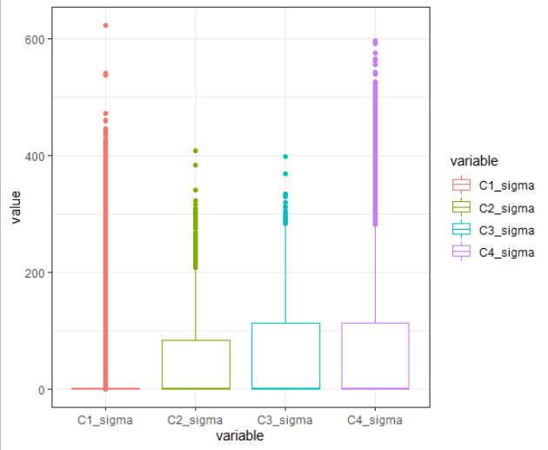
Explore Data – Sigma distribution

Slide 7
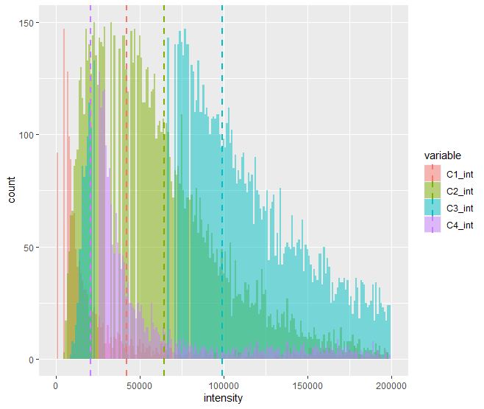
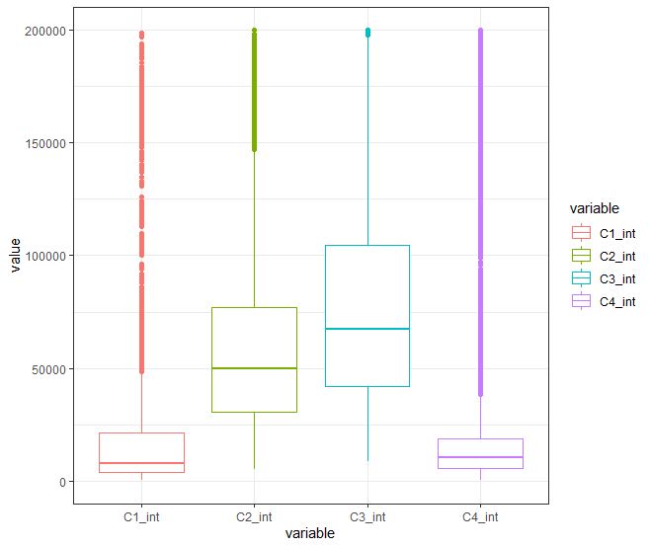
Explore Data – Intensity distribution
Sigma > 0

Slide 8
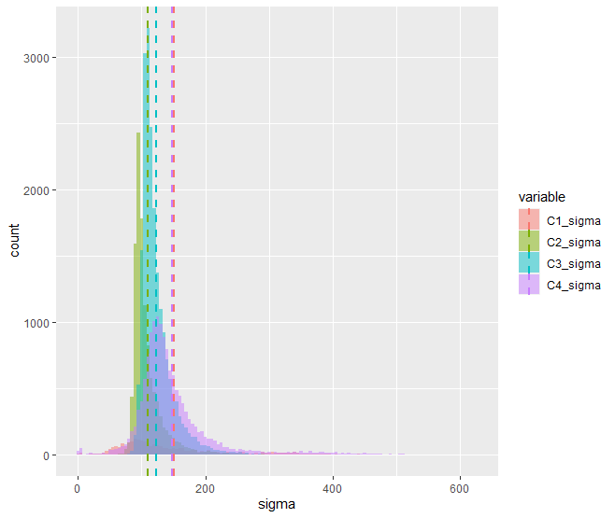
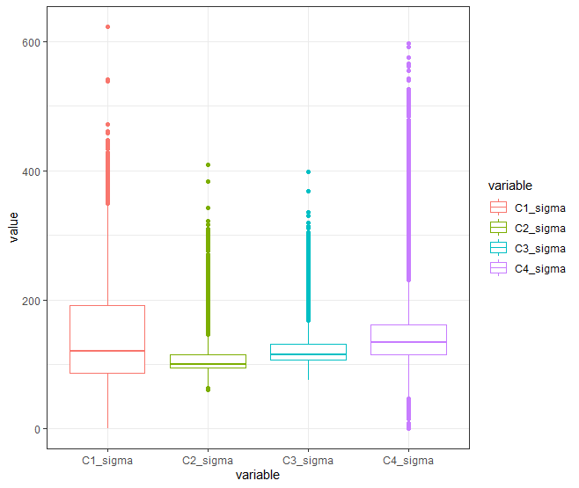
Explore Data – Sigma distribution
Sigma > 0

Slide 9
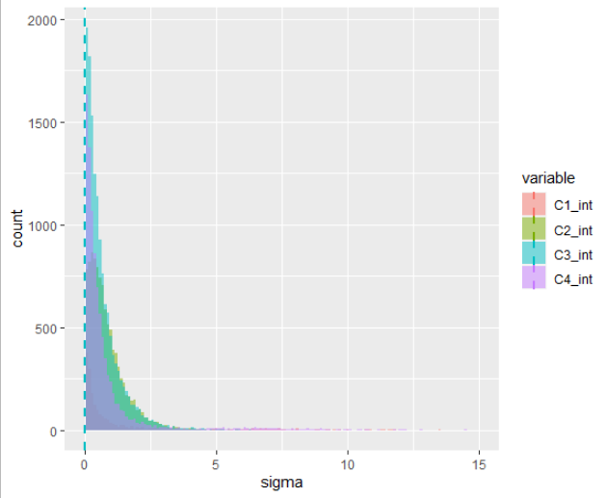
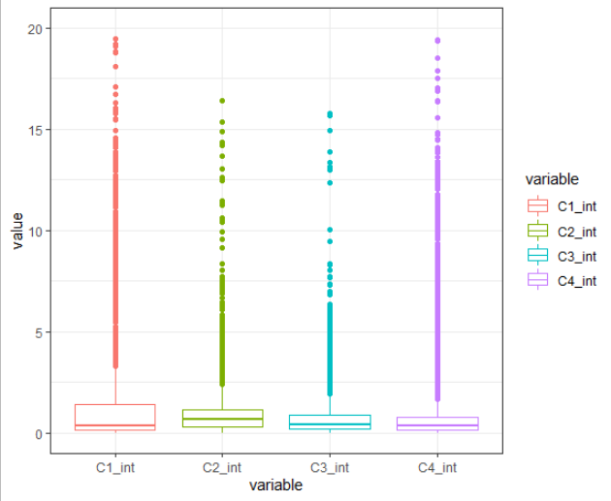
Explore Data – Intensity distribution
After Normalization

Slide 10
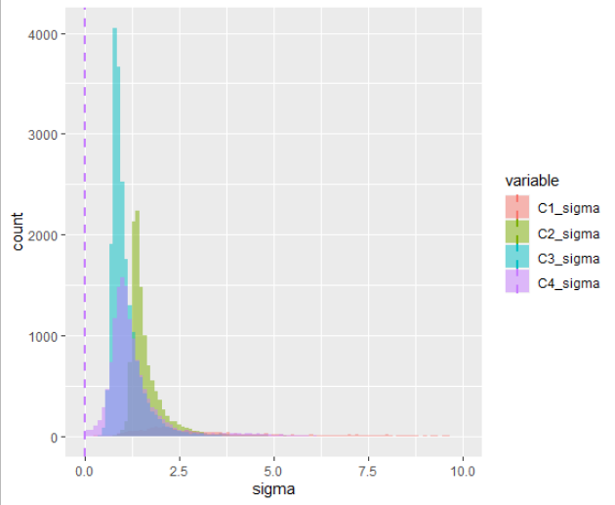
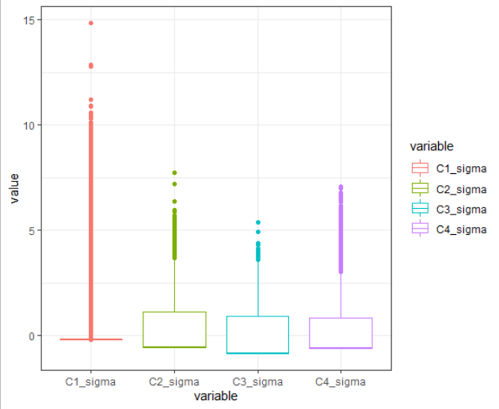
Explore Data – Sigma distribution
After Normalization

Slide 11
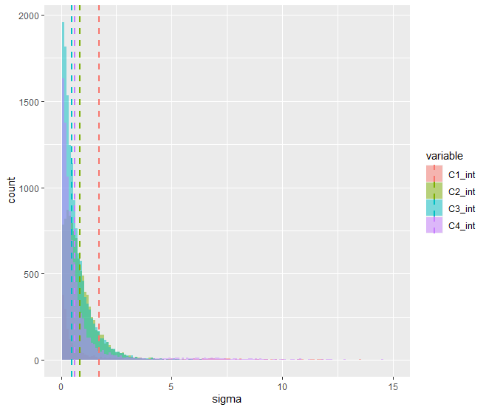
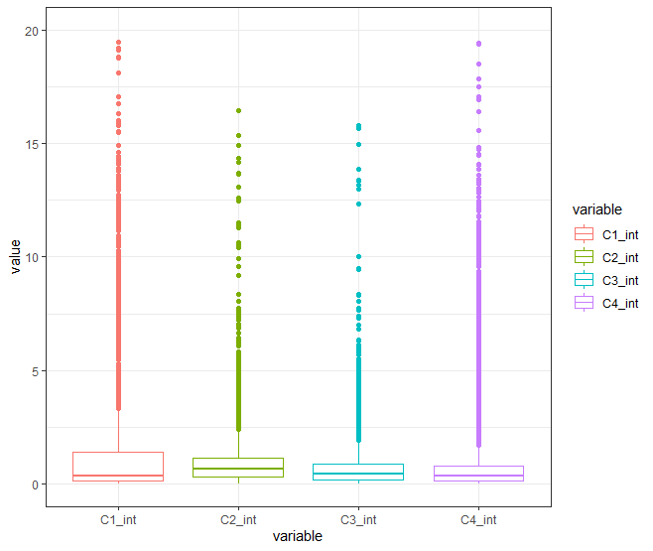
Explore Data – Intensity distribution
After Normalization
Sigma > 0

Slide 12
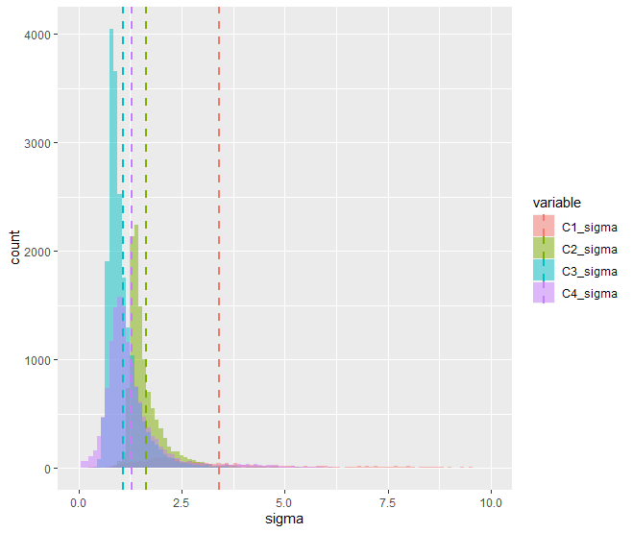
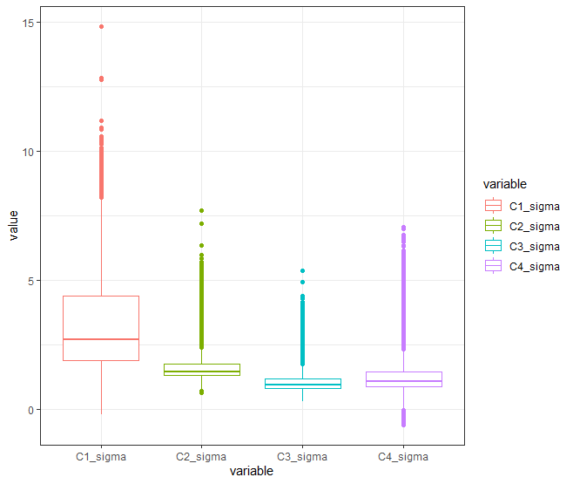
Explore Data – Sigma distribution
After Normalization
Sigma > 0

Slide 13
Cluster Analysis - Model
Normalized data
Euclidean distance
Observation with certain values of features will be clustered together
Correlation based distance methods (e.g. Pearson corr. Spearman corr.) identify clusters of observation regardless of their magnitude
K-means clustering
Most common clustering method

Slide 14
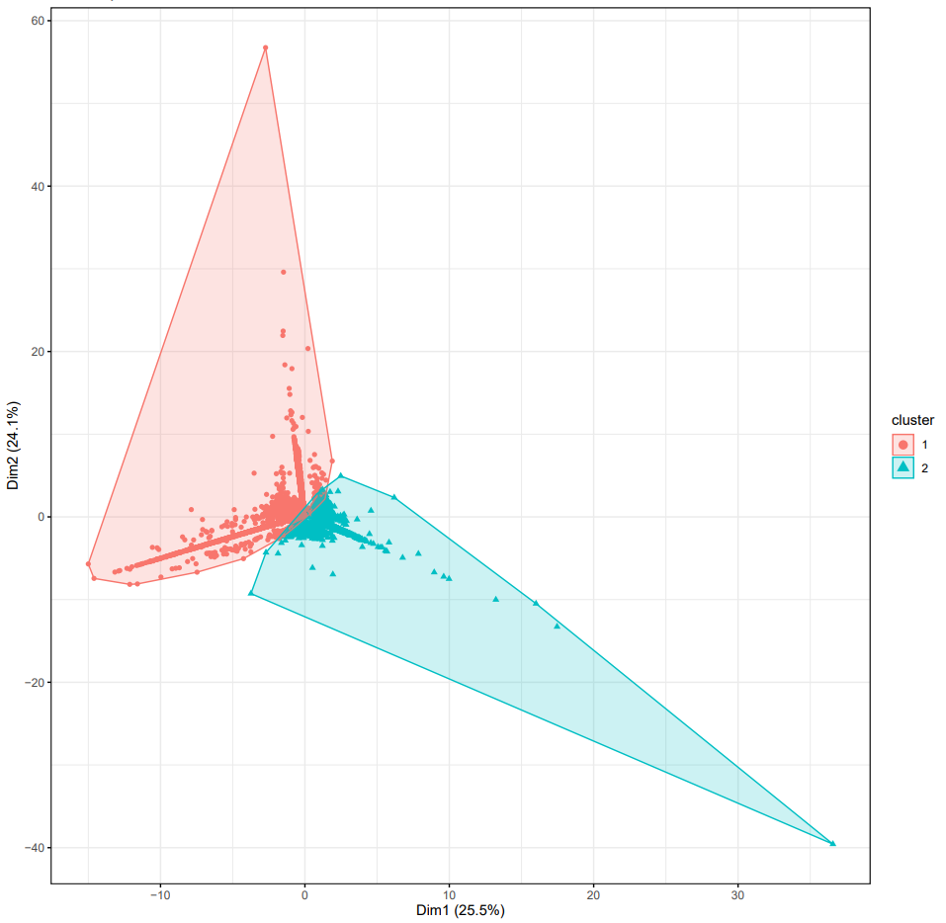
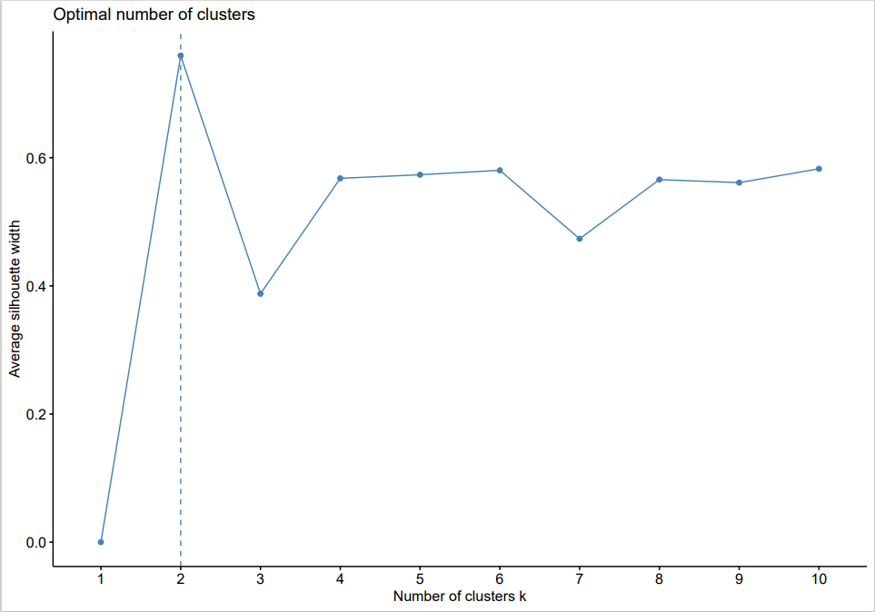
Cluster Analysis (Patient Sample)
Average silhouette coefficient
C1, C2, C4
C3

Slide 15
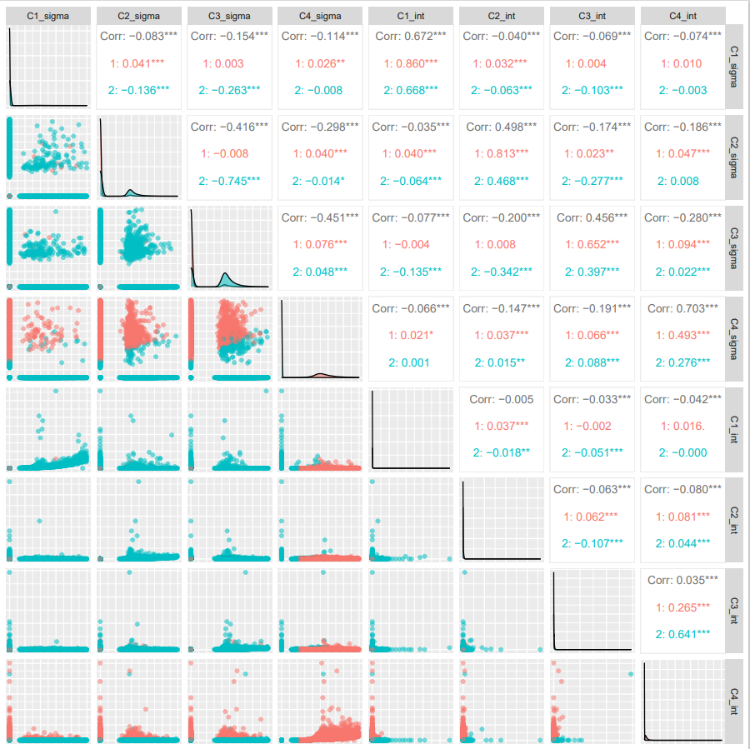
Cluster Analysis (Patient Sample)
Cluster being separated by sigma, not intensity. Especially by C3_sigma.
This can be expected from the sigma/intensity distribution in slide 7&8
High proportion of zero values

Slide 16
Cluster Analysis - Model
Normalized data
Euclidean distance
Observation with certain values of features will be clustered together
Correlation based distance methods (e.g. Pearson corr. Spearman corr.) identify clusters of observation regardless of their magnitude
K-means clustering
Most common clustering method
BUT our data contains excessive zeros (zero-inflated data)
In this case, parametric approaches (e.g. Poisson, NB) may lead to a lack of fit. In case of non-parametric approaches, the excessive zeros create a large number of ties.
Cannot assume normal distribution (if normalization : resulting vectors will have very different characteristics than actual data)

Slide 17
Alternative cluster method?
사실 그럼에도 불구하고 sigma 기준으로 cluster 는 됨.. intensity는 나뉘질 않음.
Intensity는 별 변화가 없었으나 sigma는 zero proportion이 높아서 normalization을 적용하였을 때 mean이 굉장히 skewed 됨. -> 원래의 데이터와 달라짐.
Sigma는 normal distribution을 가정할 수 없는 상태. 그렇다면 Gaussian mixture model? (R - EMCluster)
normal distribution을 가정하고 cluster 했을 때, mean은 상당히 이상해지지만, 0이 아닌 값들의 distribution은 remain. 그냥 이것으로 clustering 강행?

Slide 18
To do
Cluster analysis without unmatched spots
Try different distance/clustering parameters
Microarray digitizing (이규상 박사님과)
쓸 만한 이미지인지 감별하는 standard

